Slide 1












6ª Edición Gira Online Speakers Latam
Serverless Deep Neural Network with Azure Functions and ML.Net
Praveen Raghuvanshi
@praveenraghuvan

Slide 2


Introduction
Cloud Architect @ Harman, A Samsung Company
Domain: Professional Audio, Video and Control
Area of expertise: Cloud, Distributed Computing
Area of Interest: AI/ML and IoT
Location: Bangalore, India
Azure Certified

Slide 3
6ª Edición Gira Online Speakers Latam
Agenda
Serverless
Azure Functions
Deep Neural Network(DNN)
Image Classification
ML.Net
Demo

Slide 4
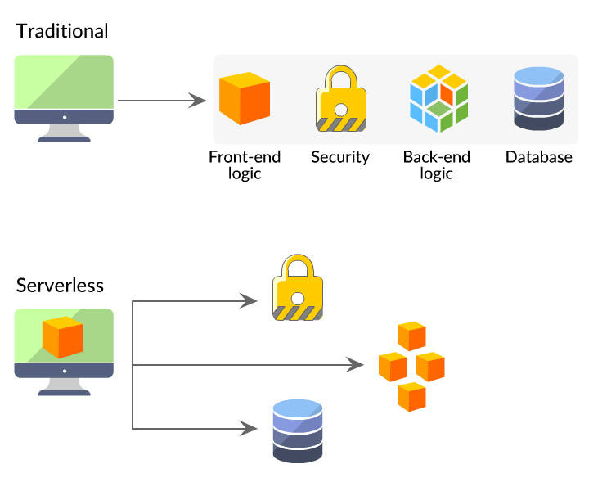
6ª Edición Gira Online Speakers Latam
Serverless
source: https://danielhkim.net/2020/02/27/serverless-cloud-computing/

Slide 5
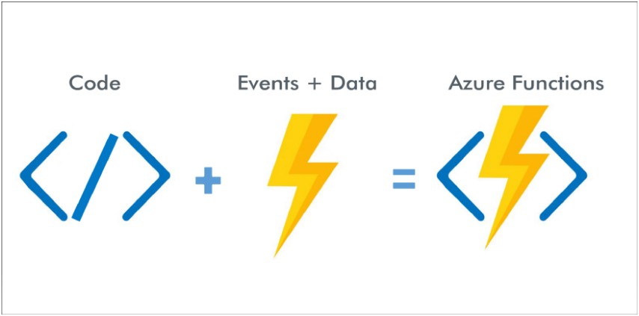
6ª Edición Gira Online Speakers Latam
Azure Functions

Slide 6
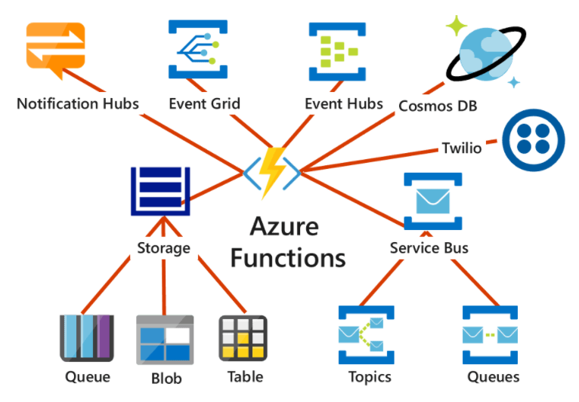
6ª Edición Gira Online Speakers Latam
Azure Functions

Slide 7
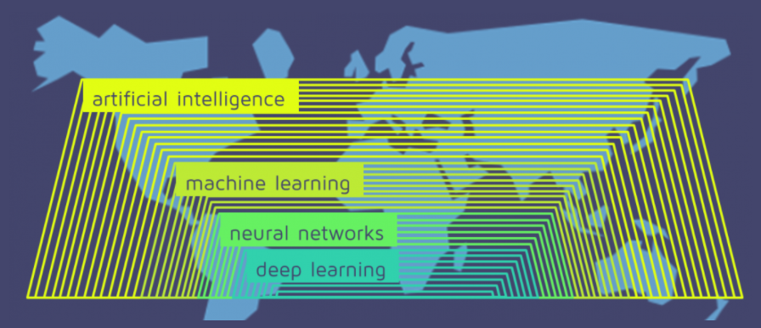
6ª Edición Gira Online Speakers Latam
Deep Neural Network
source: https://quantdare.com/what-is-the-difference-between-deep-learning-and-machine-learning/

Slide 8
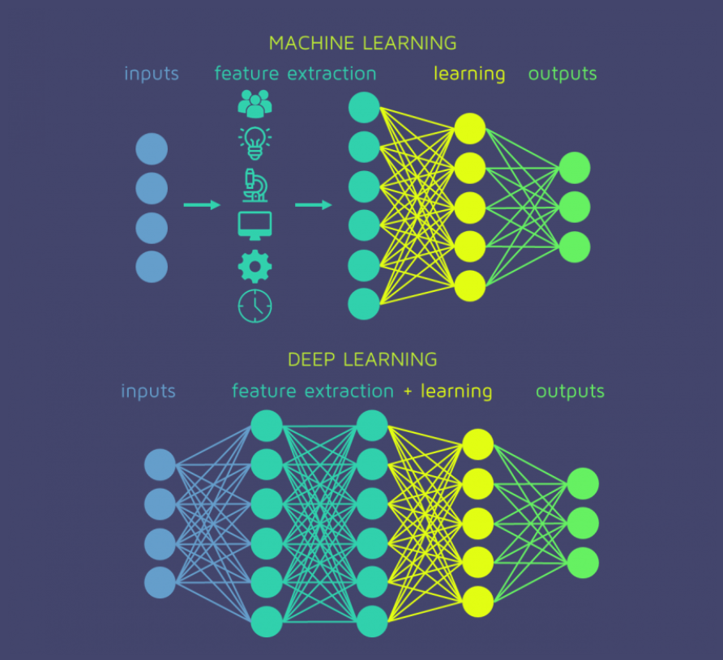
6ª Edición Gira Online Speakers Latam
Deep Neural Network
source: https://quantdare.com/what-is-the-difference-between-deep-learning-and-machine-learning/

Slide 9
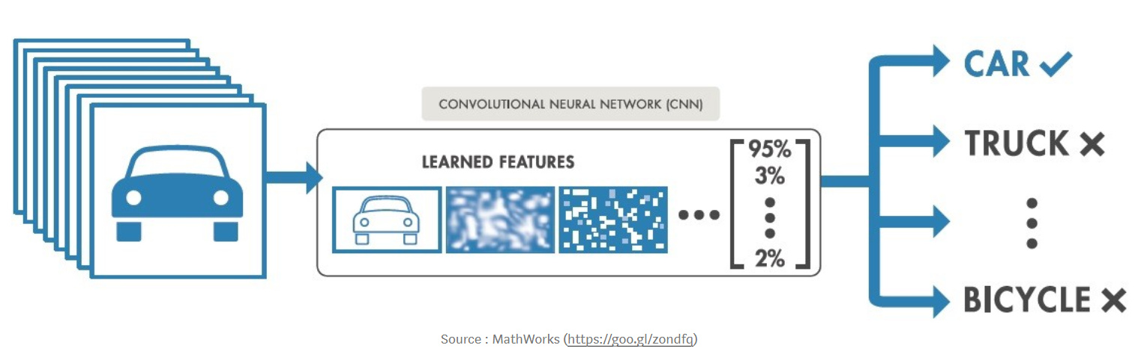
6ª Edición Gira Online Speakers Latam
Image Classification

Slide 10
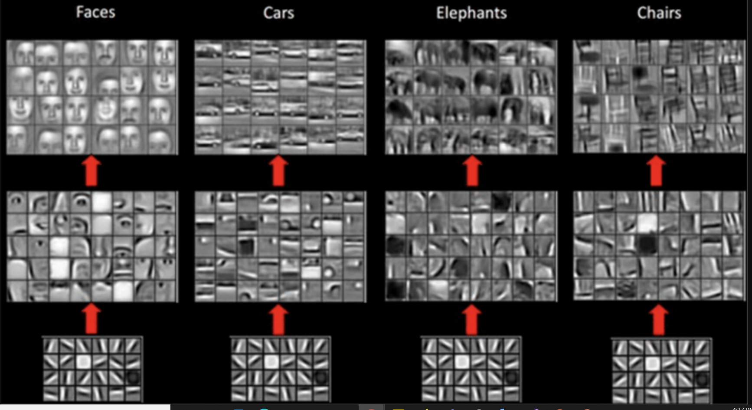
6ª Edición Gira Online Speakers Latam
Image Classification
source: https://miro.medium.com/max/1910/1*fLGuAUT5imTIGAeA4zzaWA.png

Slide 11
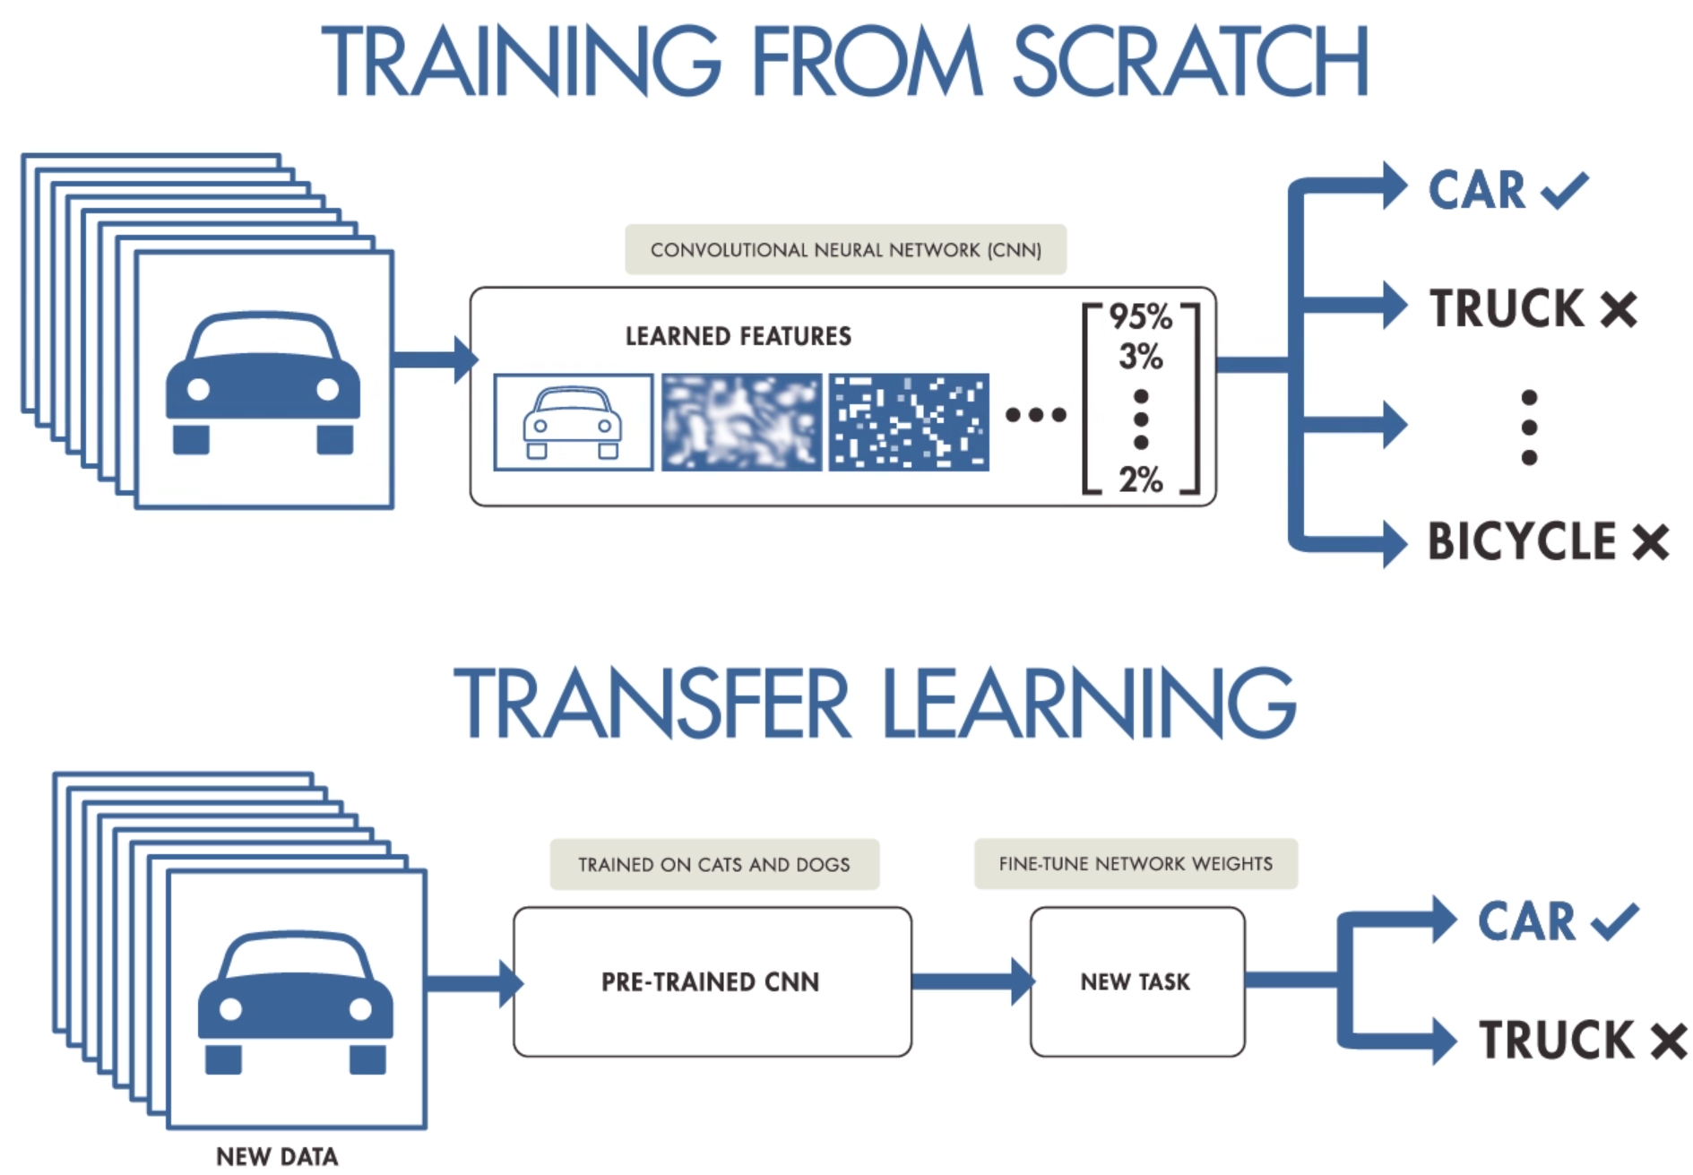
6ª Edición Gira Online Speakers Latam
Transfer Learning – Mobilenet V2
source: https://i.pinimg.com/originals/0a/76/eb/0a76eb3c95c249cdff9449af08ac4efc.png

Slide 12
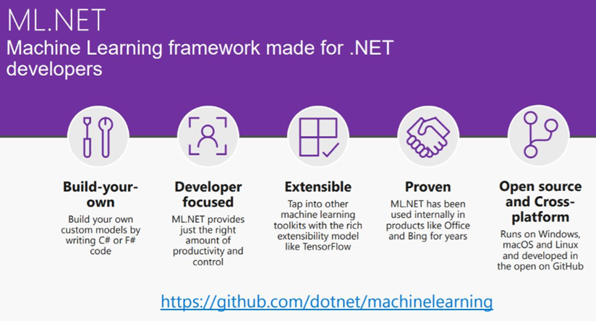
6ª Edición Gira Online Speakers Latam
ML.Net

Slide 13
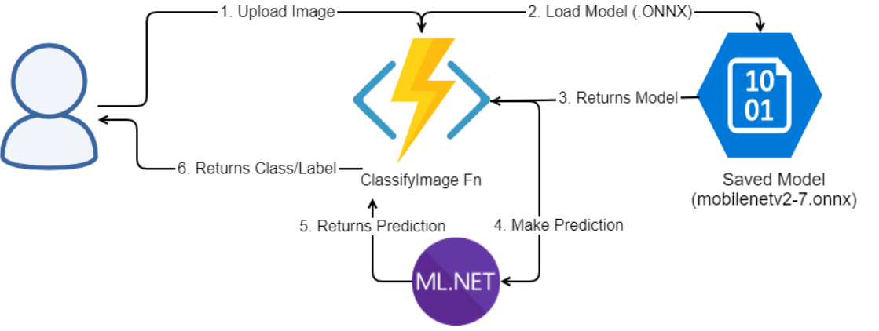
6ª Edición Gira Online Speakers Latam
Cloud Architecture

Slide 14
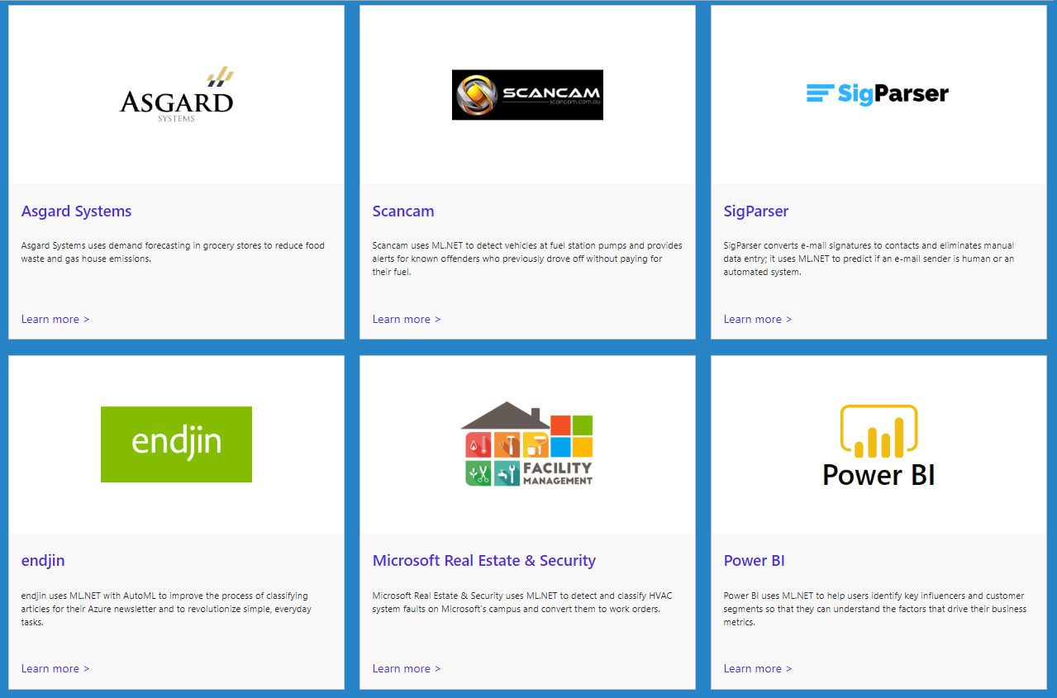
6ª Edición Gira Online Speakers Latam
Customer Success Stories – ML.Net
https://dotnet.microsoft.com/apps/machinelearning-ai/ml-dotnet/customers

Slide 15
6ª Edición Gira Online Speakers Latam
Demo

Slide 16
6ª Edición Gira Online Speakers Latam
Resources
Github: https://github.com/praveenraghuvanshi/tech-sessions/blob/master/04082022-Gira_Latam_2022

Slide 17
6ª Edición Gira Online Speakers Latam
References
Develop Azure Functions using Visual Studio
Multipart data with Azure Functions HttpTriggers
Tutorial: Train an ML.NET classification model to categorize images
Train a deep learning image classification model with ML.NET and TensorFlow
Tutorial: Detect objects using ONNX in ML.NET

Slide 18
6ª Edición Gira Online Speakers Latam
Thank you
https://linktr.ee/praveenraghuvanshi

